Slide 1
Finding Optimum Clock Frequencies for Aperiodic Test
Master’s Thesis Defense
Sindhu Gunasekar
Dept. of ECE, Auburn University
Advisory Committee: Dr. Vishwani D. Agrawal (chair),
Dr. Victor P. Nelson, Dr. Adit D. Singh
Notes:
Thank the committee and audience

Slide 2
Overview
Background
Problem Statement
Algorithm & Implementation
Results
Conclusion

Slide 3
Testing
Defects sustained during manufacturing process.
Automatic Test Equipment (ATE):
Applies input test patterns to CUT
Compares CUT output response to known good circuit output response for the given set of input test patterns.

Slide 4
Scan Design to increase testability of Sequential circuits
Reference: Dr. Nelson’s Course Website, Computer Aided Design of Digital Circuits http://www.eng.auburn.edu/~nelson/courses/elec5250_6250/

Slide 5
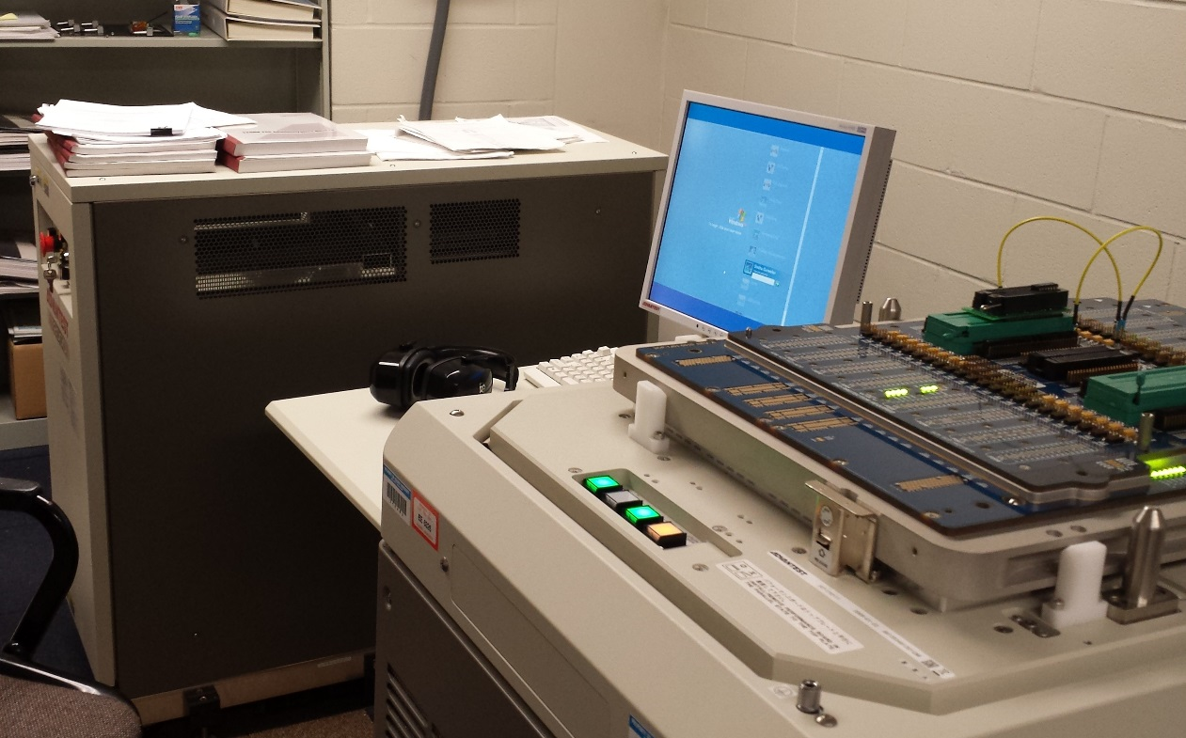
Advantest T2000GS ATE
Used to test integrated circuits for faults after fabrication.
Generates test patterns and clock to test the Device Under Test (DUT).
Performs measurements and evaluates the test results.
Consists of
Main System Unit
Test Head
User Interface

Slide 6
Testing cost of ATE
Has high initial and recurring costs.
The testing cost of using an ATE increases directly with the time spent in testing the chip.
Adds to the final cost of the chip.
It costs more to test a transistor than to manufacture it.
Reducing test time reduces cost of chip.

Slide 7
An integrated circuit is designed and packaged to handle the power dissipated during the intended function of the circuit.
The ATPG vectors used for testing are generated for high fault coverages and are functionally irrelevant signals.
High toggling activity leads to higher power dissipation.
If an aperiodic clock is used, in which the clock interval in every cycle can be modified in a way that the dynamic power dissipation remains constant throughout the test within allowable limits, test time can be significantly reduced.
Notes:
Test power is almost always higher than functional power dissipation.
Testing the circuit at functional speeds might
damage the circuit
lead to malfunction in the circuit during test.

Slide 8
Aperiodic clock test to reduce test time
Each period can be either structure constrained or power constrained, i.e.,
$$Ti=\max{\{T_{STRUCTURE}, \frac{Ei}{PMAXfunc}\}}$$
where,
T_{i} is the period of each test cycle
E_{i} is the energy dissipated by each cycle
This is termed as aperiodic clock test where each cycle may not use exactly the same period as its neighboring cycle.
For any given voltage an aperiodic clock test can run faster than the periodic clock test at that voltage
Reference: Praveen Venkataramani, Reducing ATE Test Time by Voltage and Frequency Scaling. Dissertation Defense,
Auburn University, Auburn, Alabama, USA, Nov 2013.

Slide 9
Problem Statement
The discussed methodology uses an aperiodic clock to reduce the test time.
The ATE generates only a limited number of frequencies.
Determining an optimum set of frequencies is a discrete optimization problem.
This work discusses an algorithm to obtain the optimum set of frequencies for test time reduction.

Slide 10
The Optimization Problem
Total Test Time = ∑^{k}_{i=1} n_{i} t_{i} where n_{i} is number of cycles at the period t_{i}
k is the number of different frequencies the ATE allows
t_{i} has to be determined

Slide 11
Background
Problem Statement
Algorithm & Implementation
Results
Conclusion

Slide 12
This is a Combinatorial optimization problem in the discrete domain.
It is NP-complete.
Using heuristics the NP-complete problem is solved in polynomial-time to find near-optimal solutions.
Notes:
combinatorial optimization is a topic that consists of finding an optimal object from a finite set of objects

Slide 13
Greedy Algorithm
A greedy algorithm makes the locally optimal choice that looks best at each stage.
The greedy heuristic does not always yield optimal solutions, but nonetheless it may yield locally optimal solutions that approximate a global optimal solution.
One optimum clock period is found by one iteration over all the n different clock intervals, to find which clock interval minimises the test time.
The subsequent clocks are found one at each step without altering the clocks found at the previous step.

Slide 14
Since greedy algorithm is known to converge to a local optimum, three other algorithms are implemented, but the optimal solutions are observed to be very close the solutions of the greedy algorithm.
Iterated local search is when a local search is performed to find a local optimum and then the solution is perturbed to help it escape the local optimum and restart the local search again.

Slide 15
Directed Search: One parameter is varied at any time by steps of the same magnitude, and when such increase or decrease did not improve the objective function, the step size is halved and repeated until the steps become sufficiently small.
Simulated Annealing: It is a global optimisation method. Annealing is the process of closely controlling the temperature when cooling a material to ensure that it reaches an optimal state. Simulated annealing mimics the process to find an optimum.

Slide 16
Background
Problem Statement
Algorithm & Implementation
Results
Conclusion

Slide 17
Normalised Test Time of s1238 obtained by the greedy algorithm

Slide 18
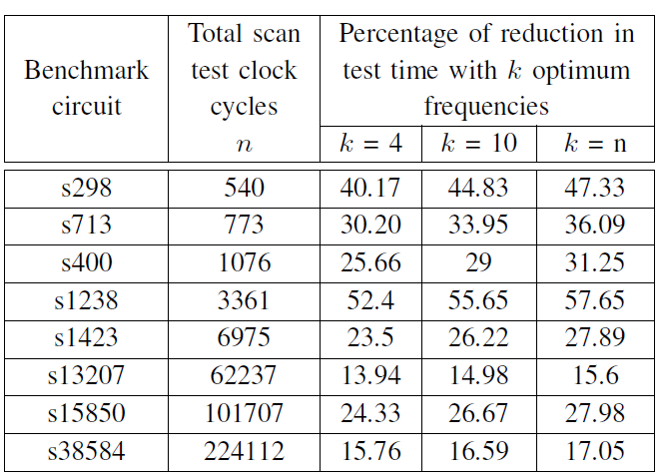
Percentage of Reduction in Test time of the ISCAS ‘89 benchmarks, with 4, 10 and n frequencies

Slide 19
Lower bound of the aperiodic test time obtained with aperiodic clocks using the greedy algorithm by simulating ISCAS '89 benchmark circuits.

Slide 20
Normalised test time of the s1238 benchmark obtained through the various algorithms

Slide 21
Percentage of reduction in test time of s1238 benchmark circuit obtained by different algorithms

Slide 22
CPU time of the four algorithms compared for the s1238 benchmark

Slide 23
S298 tested on the ATE T2000GS which allows 4 different frequencies
 | Periodic clock | Aperiodic clock with arbitrary frequencies | Aperiodic clock with frequencies computed by the greedy algorithm
Test time (μs) | 270 | 184 | 158
Percentage of reduction in test time | 0 % | 31.85% | 41.48 %

Slide 24
Periodic clock test ATE result for 540-cycle scan test of s298 benchmark circuit showing test cycles 15 to 45 with a clock of 500ns.

Slide 25
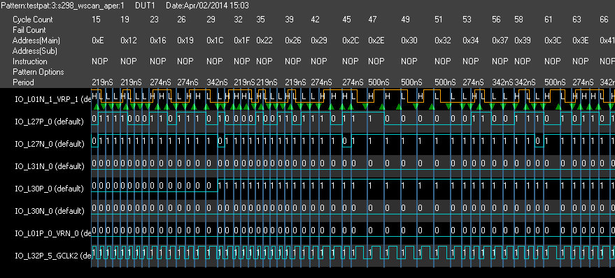
Aperiodic clock test ATE result for 540-cycle scan test of s298 benchmark circuit showing test cycles 15 to 66 with a clock periods of 219ns, 274ns, 342ns and 500ns.

Slide 26
Conclusion
The greedy algorithm to find optimum clock frequencies is proven to be as good as any of the other local search and global search algorithms, and faster than all of them.
As few as four frequencies can give a test time reduction up to 52% in a few circuits, and the computation could be completed in a time of the order of milliseconds.
Ten clock frequencies are optimum for test time reduction for most of the benchmark circuits simulated in this work, beyond which the test time reduction is negligible.

Slide 27
Future Work
The high costs of automatic test equipment (ATE) and the growing clock frequencies bring about the need to study on-chip clock generation circuitry for generation of aperiodic clocks, which can be implemented in BIST circuits where the test patterns are generated on-chip.

Slide 28
References
P. Venkataramani and V. D. Agrawal, “ATE Test Time Reduction Using Asynchronous Clocking,” in Proc. International Test Conf., Sept. 2013. Paper 15.3.
T. H. Cormen, C. E. Leiserson, R. L. Rivest, C. Stein, et al., Introduction to algorithms, volume 2. MIT press Cambridge, 2001.
P. Mangilipally and V. P. Nelson, “Emulation of Slave Serial Mode to Configure the Xilinx Spartan 3 XC3S50 FPGA Using Advantest T2000 Tester,” in Technical report, Auburn University, 2011.
S. Luke, Essentials of Metaheuristics. Lulu, second edition, 2013. Available at http://cs.gmu.edu/sean/book/metaheuristics/
P. Venkataramani, “Reducing ATE Test Time by Voltage and Frequency Scaling.” PhD thesis, Auburn University, Auburn, Alabama, USA, May 2014.
P. Venkataramani, S. Sindia, and V. D. Agrawal, “A Test Time Theorem and Its Applications,” in Proc. 14th IEEE Latin-American Test Workshop, Apr. 2013.

